Slide 1
Advanced
Console switch
IT Management Products
xx.xx.xx

Slide 2
contents
ACS8000 & ACS800 Console Switches
    Value Proposition
    Overview
    Model Comparison
    Features
    Cellular
    Part Numbers
    Product Discovery Questions
    Market Competition
    Key Takeaways

Slide 3
ACS800 & acs8000
Edge Data Center

Slide 4
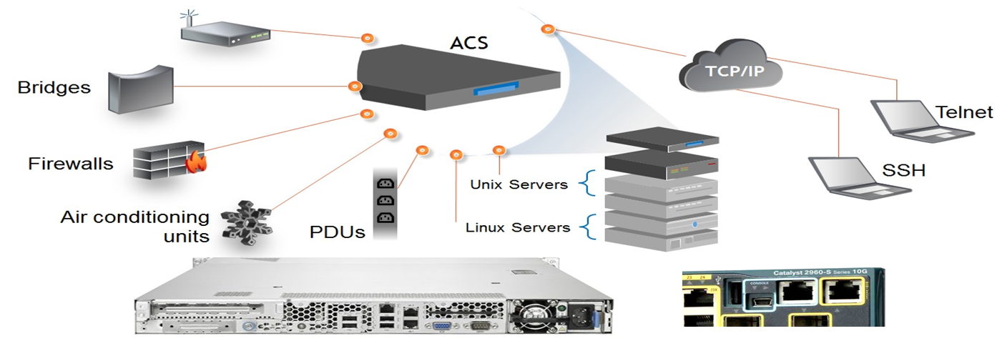
ACS Value Proposition
  Secure in-band and out-of-band remote management allowing users to manage their Serial Infrastructure
      Fast, automated configuration with Zero Touch Provisioning
      Access and troubleshoot remote locations using automatic network failover to cellular (and failback)
      Automatic pin-out detection for both Cyclades and Cisco pinouts using straight through cables
      Compliance with data center access and security policies – customizable, multiple access levels

Slide 5
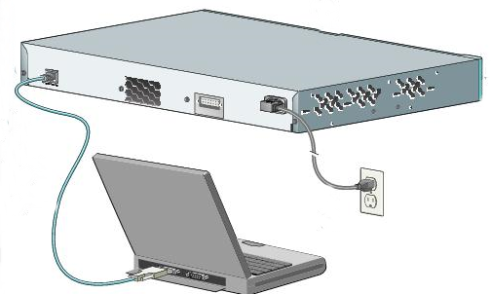
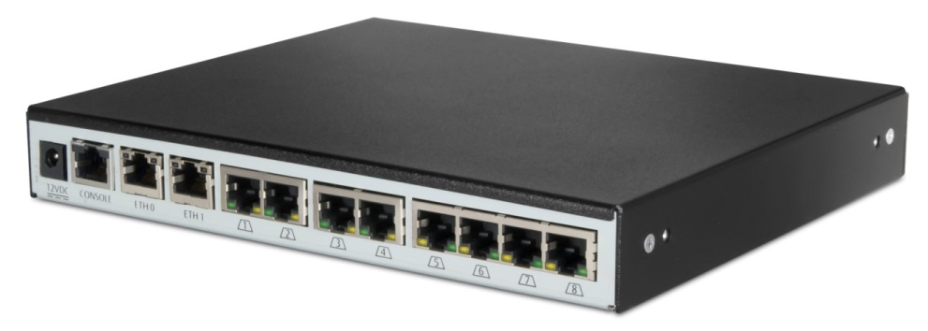
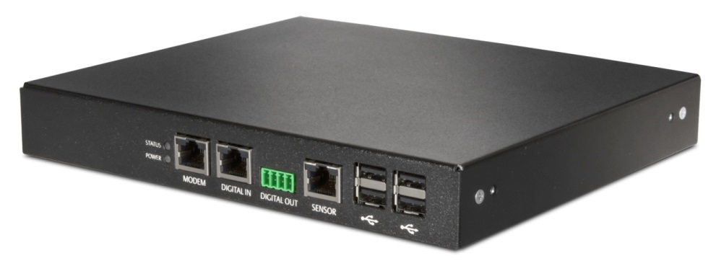
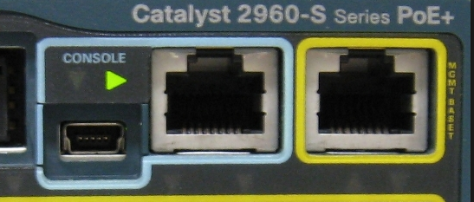


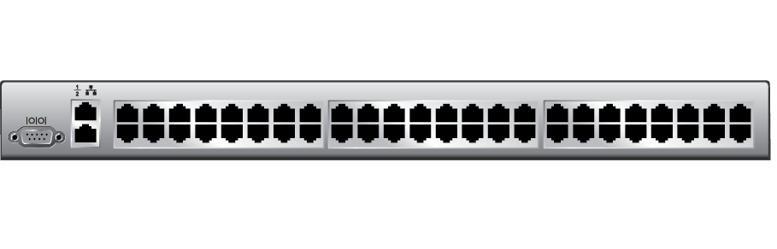

ACS Value Proposition
Without ACS
With ACS
    Locally connect to the equipment
    Standard Cat5/6/7 connection to the equipment
    USB connection to the equipment
PSTN
ACS800 / 8000
Internet
Router

Slide 6
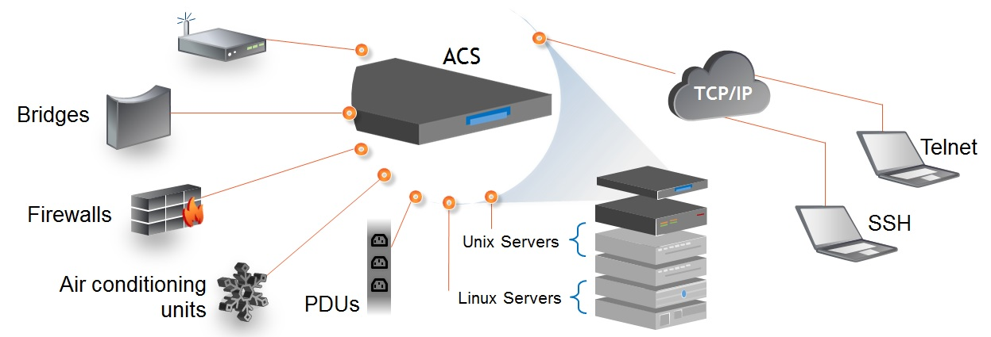

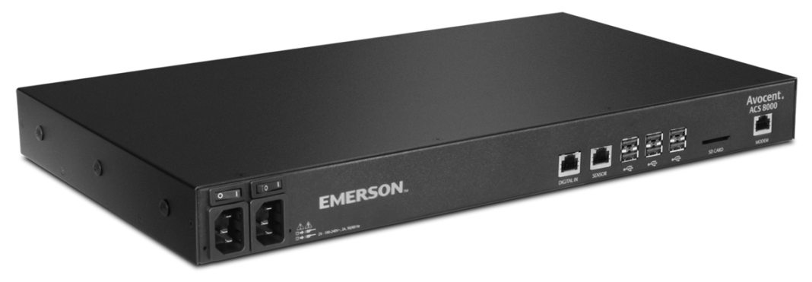
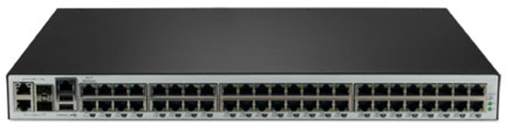
ACS8000 & acs800 overview
ACS800
ACS8000
    Smaller, compact form factor
    2, 4, and 8 port count versions
      Models w/ internal Analog Modem
      Single AC Power Pack
      19” Rack Mount Kit Available
    PERFORMANCE FEATURES
      CPU - Dual-core ARM Cortex-A9 MPCore with CoreSight
      Memory - 1GB DDR3L RAM
      16GB eMMC Flash
    CONNECTIVITY FEATURES
      (2) NIC’s – Dual Gigabit Ethernet Ports
      (4) USB 2.0 ports
      Sensor Port
      Digital Input and Digital Output Ports
      Multi-protocol support (RS-485/RS-422/RS-232)
    8, 16, 32 and 48 port count versions
      Models w/ internal Analog Modem
      Single/Dual AC Power and Single/Dual DC Power
      Zero-U Rack Mount Kit Available
    PERFORMANCE FEATURES
      CPU - Dual-core ARM Cortex-A9 MPCore with CoreSight
      Memory - 1GB DDR3L RAM
      16GB eMMC Flash
    CONNECTIVITY FEATURES
      (2) NIC’s – Dual Gigabit Ethernet Ports
      (2) SFP Fibre-Optic Ports
      (8) USB 2.0 ports
      Sensor Port
      Digital Input Ports
      Multi-protocol support (RS-485/RS-422/RS-232)

Slide 7
Acs Model Comparison
Model Feature | ACS 8000 | ACS 800
CPU | Dual-core ARM® Cortex™-A9 | Dual-core ARM® Cortex™-A9
Memory | 1GB | 1GB
Storage | 16GB | 16GB
Port Range | 8,16,32,48 | 2, 4, 8
Power Supplies | Single/Dual AC/DC | Single AC
Dual LAN | Yes | Yes
Soft-Pin Out | Yes | Yes
SD-Card Slot | Yes | No
SFP Slot | Yes | No
USB Ports | 8 | 4
Sensor Options | Yes | Yes
Internal Analog Modem | Yes | Yes
Cellular Modem Support | Yes | Yes
Multi Protocol Ports | Yes (Ports 1 & 2 only) | Yes (All Ports)

Slide 8
ACS features
Features
Benefits
    Fast, automated configuration with Zero Touch Provisioning
    Access and troubleshoot remote locations using automatic network failover to cellular (and failback)
    No need for adaptors with automatic Cyclades™ and Cisco pin-out conversions
    Expanded support for Rack PDUs from Vertiv, ServerTech, APC, Raritan and Eaton
    Support for Vertiv GXT4 UPS systems
    Integrated support for 1Gb SFP fibre modules
    USB ports to support new IT equipment console ports (USB Serial) and USB external devices
    Secure in-band and out-of-band network remote management
    Remotely manage and control IT assets from anywhere in the world
    Maximize productivity while providing scalability and reducing operational costs.
    Ensure compliance with data center access and security policies – customizable, multiple access levels

Slide 9
Standard software features
ACS800
ACS8000
    2 Factor authentication (RSA SecureID)
    OTP (One Time Password)
    SSHv1 and SSHv2
    SNMPv3 support
    Zero Touch Provisioning
    Onboard Web UI, DSView single-pane of glass
    Scripting support via CLI, Bash, Awk, Python (New), Perl (New)
    Network authentication via Local, RADIUS, TACACS+, LDAP, Active Directory
    Analog modem dial-up authentication via PAP, CHAP and EAP
    Encryption support via TLSv1.2, SSLv3, AES128/256, SHA256/384

Slide 10

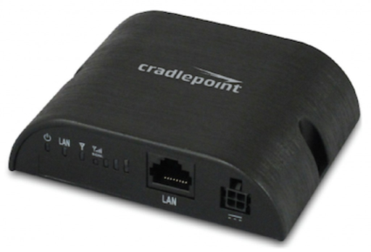
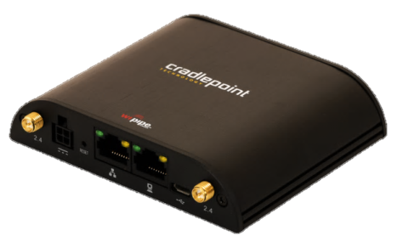
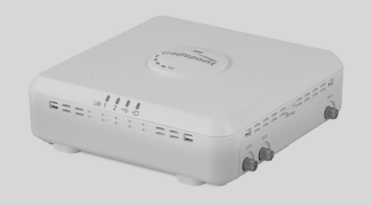
Cellular
Cradlepoint Cellular Enablement
    We have partnered with Cradlepoint, Inc. to enable ACS with cellular connectivity
    COR IBR350
      Plastic enclosure, 0C-40C, Dual-SIM, IPSec/VPN, LTE only, 4G/LTE, 3G/LTE
    COR IBR650
      Metal enclosure, 0C-50C, Single-SIM, GPS, IPSec/VPN, 4G/LTE
    ARC CBA850
      Plastic enclosure, 0C-50C, Dual-SIM, GPS, PoE, IP-PassThru, 4G/LTE

Slide 11
ACS8000 SKUs
Part Number | Description
ACS8008SAC-400 | 8-Port ACS8000 Console System with single AC Power Supply
ACS8008SDC-400 | 8-Port ACS8000 Console System with single DC Power Supply
ACS8008DAC-400 | 8-Port ACS8000 Console System with dual AC Power Supply
ACS8008MSDC-400 | 8-Port ACS8000 Console System with single DC Power Supply and Analog Modem
ACS8008MDAC-400 | 8-Port ACS8000 Console System with dual AC Power Supply and Analog Modem
ACS8016SAC-400 | 16-Port ACS8000 Console System with single AC Power Supply
ACS8016DAC-400 | 16-Port ACS8000 Console System with dual AC Power Supply
ACS8016MDAC-400 | 16-Port ACS8000 Console System with dual AC Power Supply and Analog Modem
ACS8032SAC-400 | 32-Port ACS8000 Console System with single AC Power Supply
ACS8032DAC-400 | 32-Port ACS8000 Console System with dual AC Power Supply
ACS8032DDC-400 | 32-Port ACS8000 Console System with dual DC Power Supply
ACS8032MDAC-400 | 32-Port ACS8000 Console System with dual AC Power Supply and Analog Modem
ACS8032MDDC-400 | 32-Port ACS8000 Console System with dual DC Power Supply and Analog Modem
ACS8048SAC-400 | 48-Port ACS8000 Console System with single AC Power Supply
ACS8048DAC-400 | 48-Port ACS8000 Console System with dual AC Power Supply
ACS8048DDC-400 | 48-Port ACS8000 Console System with dual DC Power Supply
ACS8048MDAC-400 | 48-Port ACS8000 Console System with dual AC Power Supply and Analog Modem
ACS8048MDDC-400 | 48-Port ACS8000 Console System with dual DC Power Supply and Analog Modem

Slide 12
ACS800 SKUs
Part Number | Description
ACS802EAC-400 | 2-Port ACS800 Serial Console with external AC/DC Power Brick - Jumper cord: Plug C14 to connector C13
ACS802EAC-201 | 2-Port ACS800 Serial Console with external AC/DC Power Brick - UK power cord: Plug CEE 7/7 to connector C13
ACS802EAC-202 | 2-Port ACS800 Serial Console with external AC/DC Power Brick - EU power cord: Plug CEE 7/7 to connector C13
ACS802MEAC-400 | 2-Port ACS800 Serial Console with analog modem, external AC/DC Power Brick - Jumper cord: Plug C14 to connector C13
ACS802MEAC-201 | 2-Port ACS800 Serial Console with analog modem, external AC/DC Power Brick - UK power cord: Plug CEE 7/7 to connector C13
ACS802MEAC-202 | 2-Port ACS800 Serial Console with analog modem, external AC/DC Power Brick - EU power cord: Plug CEE 7/7 to connector C13
ACS804EAC-400 | 4-Port ACS800 Serial Console with external AC/DC Power Brick - Jumper cord: Plug C14 to connector C13
ACS804EAC-201 | 4-Port ACS800 Serial Console with external AC/DC Power Brick - UK power cord: Plug CEE 7/7 to connector C13
ACS804EAC-202 | 4-Port ACS800 Serial Console with external AC/DC Power Brick - EU power cord: Plug CEE 7/7 to connector C13
ACS804MEAC-400 | 4-Port ACS800 Serial Console with analog modem, external AC/DC Power Brick - Jumper cord: Plug C14 to connector C13
ACS804MEAC-201 | 4-Port ACS800 Serial Console with analog modem, external AC/DC Power Brick - UK power cord: Plug CEE 7/7 to connector C13
ACS804MEAC-202 | 4-Port ACS800 Serial Console with analog modem, external AC/DC Power Brick - EU power cord: Plug CEE 7/7 to connector C13
ACS808EAC-400 | 8-Port ACS800 Serial Console with external AC/DC Power Brick - Jumper cord: Plug C14 to connector C13
ACS808EAC-201 | 8-Port ACS800 Serial Console with external AC/DC Power Brick - UK power cord: Plug CEE 7/7 to connector C13
ACS808EAC-202 | 8-Port ACS800 Serial Console with external AC/DC Power Brick - EU power cord: Plug CEE 7/7 to connector C13
ACS808MEAC-400 | 8-Port ACS800 Serial Console with analog modem, external AC/DC Power Brick - Jumper cord: Plug C14 to connector C13
ACS808MEAC-201 | 8-Port ACS800 Serial Console with analog modem, external AC/DC Power Brick -UK power cord: Plug CEE 7/7 to connector C13
ACS808MEAC-202 | 8-Port ACS800 Serial Console with analog modem, external AC/DC Power Brick - EU power cord: Plug CEE 7/7 to connector C13

Slide 13
Product Discovery questions
Discovery Questions
Roles
    How are you centrally managing your Serial Infrastructure?
    How do you currently handle a network outage?
    Do you have the ability to perform “hard” power operations remotely even if your network infrastructure is currently down?
    How are you managing your remote facilities?
    (Works for the entire Vertiv Enterprise offering)
    Network Administrator
    Linux/Unix Server Administrator
    Storage Administrator
    Telecommunications Administrator

Slide 14

ACS market competition
    Competitive Information
    Vertiv is the industry leader in the space
    Competitors do not have any significant technological benefits over the Vertiv solution
    Our Advantage
    Vertiv is the industry leader in the space
    Trusted solution in the market with ACS product supply for 10+ years
    Competitors do not have any significant technological benefits over the Vertiv solution

Slide 15
ACS Market Challenges
  What are the possible challenges/objections for this product?
    Cellular not integrated in to the unit
  How do we respond to challenges/objections?
    Using an external CradlePoint solution(s) allows for
      Customer Flexibility
        Not fixed to just one solution, can select from three difference products based on their needs.(Cellular provider, Dual / Single SIM, IPSec/VPN or IP-PassThru)
        Positioning of the unit within the data center to obtain maximum cellular reception. (The units can be up to 100m away from the ACS)

Slide 16
ACS Takeaways
  ACS800 is ideally suited for Edge
  ACS8000 is ideally suited for Data Center
  Multi-protocol support (RS232, RS422 & RS485)
  Cellular and PSTN Modem connection supported
  Expanded support for Vertiv Rack PDU and UPS

