Slide 1
Vertiv™ EDGE UPS
Superior Power Protection for Edge Applications
June 2020
Rev.02

Slide 2
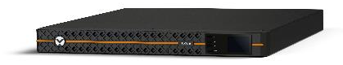
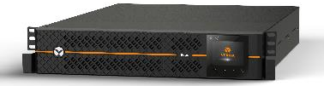

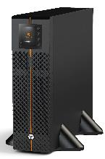

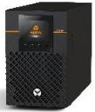


Vertiv™ EDGE 1ph UPS
Warranty to be defined on each Region
Vertiv EDGE
Key Features and Applications
Superior Power Protection for Edge Applications
Line interactive (VI) UPS technology for professional applications Complete product family with ratings from 500 VA up to 3 kVA High output power factor (0.9) Controllable sockets (1 group) Flexibility with 1U, 2U, 3U and tower form factor versions Color LCD display Same external battery cabinets compatible with Vertiv™ GXT5 3 years standard warranty (batteries and electronics) Railkits included in the UPS
Retail and PoS
Network closets
Branch offices
Telecom access
EDGE systems
Applications:

Slide 3
Vertiv™ EDGE battery configuration
Models | Model Number | Rating | Internal batteries | Battery configuration (UPS) | Extended runtime capabillty and EBC
 | EDGE-750IMT | 750VA / 630W | Yes | 2 x 12V x 9Ahr (24V DC) | No
 | EDGE-1000IMT | 1000VA / 900W | Yes | 2 x 12V x 10Ahr (24V DC) | No
 | EDGE-1500IMT | 1500VA / 1350W | Yes | 4 x 12V x 9Ahr (48V DC) | No
 | EDGE-500IRM1U | 500VA / 300W | Yes | 2 x 6V x 9Ahr (12V DC) | No
 | EDGE-1000IRM1U | 1000VA / 900W | Yes | 4 x 6V x 9Ahr (24V DC) | No
 | EDGE-1500IRM1U | 1500VA / 1350W | Yes | 6 x 6V x 9Ahr (36V DC) | No
 | EDGE-1500IRT2UXL | 1500VA / 1350W | Yes | 4 x 12V x 9Ahr (48V DC) | Yes (GXT5-EBC48VRT2U)
 | EDGE-22000IRT2UXL | 2200VA / 1980W | Yes | 6 x 12V x 7Ahr (72V DC) | Yes (GXT5-EBC72VRT2U)
 | EDGE-3000IRT2UXL | 3000VA / 2700W | Yes | 6 x 12V x 10Ahr (72V DC) | Yes (GXT5-EBC72VRT2U)
 | EDGE-3000IRT3UXL | 3000VA / 2700W | Yes | 6 x 12V x 10Ahr (72V DC) | Yes (GXT5-EBC72VRT2U)
Internal recharge time: 3 hours @ 90% typical
Internal charger: 1.5 Amps for Tower and 1U Rack models
          3 Amps for 1500/2200/3000VA Rack/Tower models
Advanced charger with 3 stages profile
Notes:
Representative of 3kVA and below systems. Vertiv badge is push button to access the battery compartment for replacement. Display integrated in bezel.
Also no this page is the new UPS model number scheme for sharing. Conforming to more market consistent number which outlines the product, rating, capacity, voltage and EBC support.
Batteries are on left side, no airflow; airflow only on right side

Slide 4

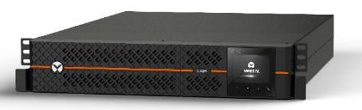
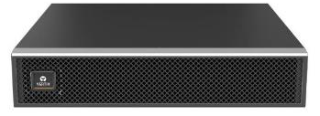
Vertiv™ EDGE External battery cabinets
Vertiv™ EDGE uses external battery cabinets (EBCs) in selected ratings for those applications requiring a long backup time
Same EBCs used in Vertiv™ GXT5 models
Ratings compatible with external battery cabinets:
1500VA RT 2U (EDGE-1500IRT2UXL)
  Compatible EBC: GXT5-EBC48VRT2U
2200VA RT 2U (EDGE-2200IRT2UXL)
  Compatible EBC: GXT5-EBC72VRT2U
3000VA RT 2U (EDGE-3000IRT2UXL)
  Compatible EBC: GXT5-EBC72VRT2U
3000VA RT 3U (EDGE-3000IRT3UXL)
  Compatible EBC: GXT5-EBC72VRT2U
Vertiv EDGE features automatic battery detection. Use a dedicated cable and the UPS will automatically recognize the EBC connected.
It is possible to connect up to 6 external battery cabinets
Vertiv™ EDGE 1.5kVA RT 2U
Vertiv™ GXT5 48V external battery cabinet
        No need of configuration at LCD about quantity of external battery cabinets.
        Make easier configuration for the user
Same EBCs in both Vertiv EDGE and Vertiv GXT5 product families means stock simplification for our Partners and Customers

Slide 5
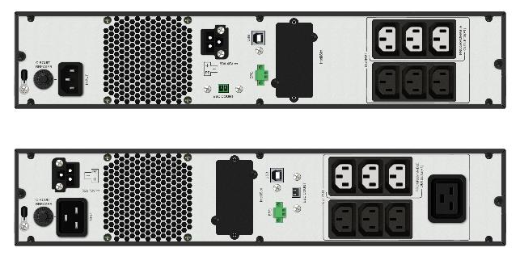
Vertiv™ EDGE External battery cabinets autodetection
    External battery cabinets:
      Up to 6 external battery cabinets
      Same EBCs as Vertiv GXT5 micro UPS
      2Us height (88 mm)
      Proper connection of battery cabinets requires
        Power cable (3 poles, power)
        Battery detection (2 wires, signal)
Power battery connector
EDGE 1500VA RT 2Us
Connector for automatic battery cabinet detection
      Key advantages of automatic battery detection feature:
        No need of configuration at LCD about quantity of external battery cabinets.
        Make easier configuration for the user
EDGE 2200 / 3000VA RT 2Us

